Slide 2
House Prices Prediction using Advanced Regression Techniques
Capstone Project Fall 2022
Professor : Safa Shubbar
Team Members :
Thanmayee Gottipati
Sai Krishna Reddy Battu
Shiva Reddy Arrabothu

Slide 3
Abstract
Calculating the price of a house depends on various factors like locality, Size of the house, Year of the house build, etc.
The main objective of this project is to help both the buyers and the sellers by estimating the price of any house by analyzing the past market trends and prices.
This model uses advanced regression techniques to predict the prices.

Slide 4
We can practice predicting of house prices using different models and below are the different regression models they are: -
1. Linear regression 2. Random forest regression 3. Lasso Regression 4. XGBoost regression model etc.

Slide 5
XGBoost
XGBoost (Extreme Gradient Boosting) is a machine learning library that uses boosting framework.
It is scalable.
This model is built sequentially.
It uses the previous classifier's success in the next model to increase the efficiency of the output.
It also processes fast compared to the other algorithms as it uses parallelization.

Slide 6
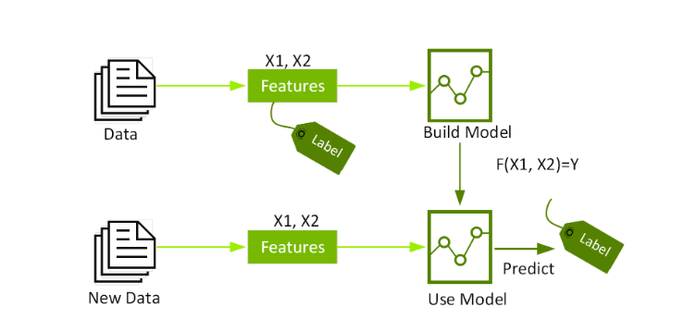

Slide 7
Random Forest
Random forest regression is an algorithm that combines the multiple predictions and gets the average of all the above to get an accurate prediction.
All the predictions are done parallelly.
This is a time taking process as it needs to combine N number of predictions to form an actual prediction.
Also, This algorithm is not scalable.

Slide 8
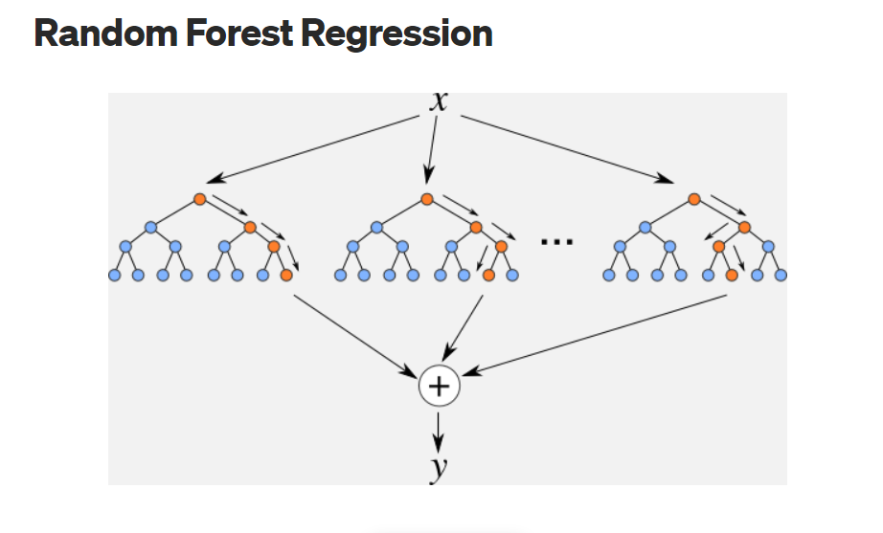

Slide 9
Identifying Customers
In this case, the customers are house sellers, construction companies etc.
All the individual house sellers are treated as end user because they are the one’s that takes input from the buyers like the type of house, size, physical conditions nearby etc.

Slide 10
Constraints imposed by customer
Here are some of the important constraints that a customer can impose such as build quality, number of bedrooms, number of bathrooms, facing of the house and total area of the house etc.
There are also some other time constraints that a customer may impose. Like they need the house within a specific period of time.

Slide 11
Assumptions and risks
Some of the risks are mainly with the customers using this application i: e they need to be aware of the application fully so that they can avoid mistakes while taking the input from the user and at the same time the application is managed by the employees or customers, errors might occur in regular intervals.
They might add more requirements or modify the values in the middle of the process.
In conclusion the overall price of a house also depends on the regression technique that we used.

Slide 12
Languages used
Here we are using python language to build the project.

Slide 13
Literature Review

Slide 14
Paper 1
HOUSE PRICE PREDICTION USING ADVANCED REGRESSION TECHNIQUES
Published Year: [2020]
https://jespublication.com/upload/2020-1106157.pdf
Authors: Mr. P. Ravindra, Assistant Professor, Department of Computer Science and Engineering, Matrusri Engineering College, Saidabad, Hyderabad, Telangana

Slide 15
In this paper they have discussed about how house price prediction can help both the developer's estimation of a home's selling price as well as the customer's timing to arrange the money for it. It requires a more precise strategy based on location, house type, size, year of construction, nearby facilities, and other elements that may influence the demand and supply for houses.
Regression modeling is used in this paper to predict the cost of home.
By examining recent market trends and pricing ranges, it makes predictions about the property price for customers based on their goals and budgets.

Slide 16
Their approach to prediction is to use regression techniques. In this project they have used Lasso Regression techniques for price prediction analysis.
LASSO stands for Least Absolute Shrinkage and Selection Operator. In statistics and machine learning, lasso is a regression analysis method that performs both variable selection and regularization in order to enhance the prediction accuracy. It Shrinkage is where data values are shrunk towards a central point, like the mean.

Slide 17
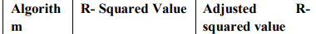
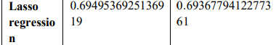
Evaluation

Slide 18
They have developed a user interface which allows the user to Register, Login, and Logout and enter features of the house as input based on his/her requirements.
Based on the inputs provided by the user accurate house price is predicted by the model and displayed on the Interface
Their future enhancements are to develop a mobile application including all these features.

Slide 19
Paper 2
Housing Price Prediction Using Linear Regression
Published Year: 2021
https://www.jetir.org/papers/JETIR2110302.pdf
Authors: Siddhant Burse, Dhriti Anjaria, Hrishikesh Balaji

Slide 20
The main objective of this paper is to predict the current market price of a home in Mumbai. Factors like the number of bedrooms, availability of different types of amenities are taken into account while doing so.
This prediction is to help a customer look for viable options which are more suitable to their requirements
They have used the Linear regression model to predict the cost of the various houses

Slide 21
In this paper, their main objective is to build a model that will predict the price of real estate in Mumbai using a linear regression algorithm
They used “Housing Prices in Mumbai” dataset from Kaggle.
The dataset consists of different factors like price and location.
From this dataset, they have choosed 33% of the data as the testing data, while the other 67% was chosen as training data

Slide 22
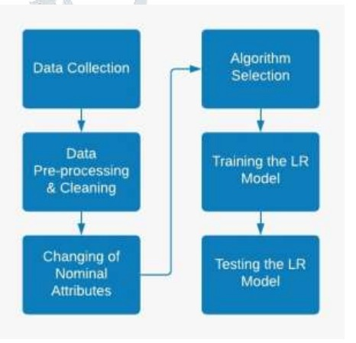
Process flow

Slide 23
In this paper they have used the data from Kaggle website and while selecting the data it need to be very precise because it has a direct affect on the prediction result.
Most of the time the data we have collected is noisy and data cleaning helps in remove empty fields, incorrect data etc.
Changing of nominal attributes helps in calculating of the price depends upon the location, because we cannot use the location directly in our prediction model.
They have used Multiple Linear regression model

Slide 24
They have processed the dataset to remove any noisy data and outliers.
They have divided this dataset to 67 percent to train the linear regression model and then used the rest of the 33 percent of dataset to test the selected model.
This data will pass through a regression model to calculate the coefficients of attributes.
The future of this paper is to make it like a live website on the internet after adding features like trends in a particular location, comparison with other properties to make it available for everyone

Slide 25
Stake Holder
Venkat Reddy Meka : mekavenkatreddy@gmail.com
12.5 years of experience in TCS
Worked as developer and production support lead for TATA Teleservices Ltd in India. (09 to 16).
Later, worked for Omantel in Dubai as Lead developer & Solution designer.(16 - 19)
Presently working as Solution Architect at Vodafone UK, London UK(19-22).

Slide 26
Execution Steps
As we know that the entire data set is portioned into train dataset and test dataset.
We also found that train data has a variable called “sales price” which is not present in the test data because we are calculating the sales price using test data.

Slide 27
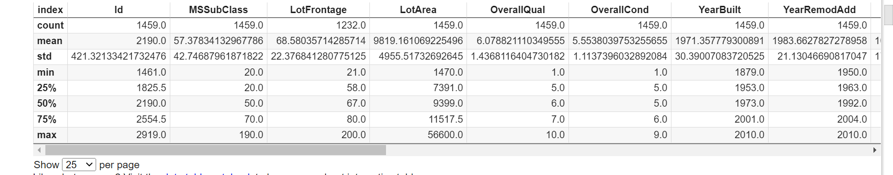

Slide 28
Followed by observing the variables in datasets, the next step in the execution flow is getting the information of the train dataset.
It gives the following information like the data type of every variable as shown below

Slide 29
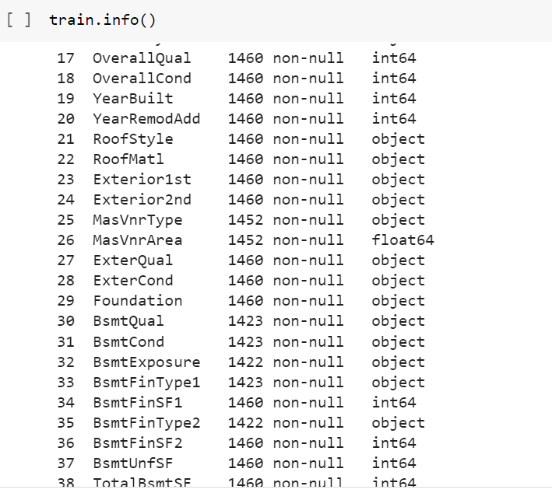

Slide 30
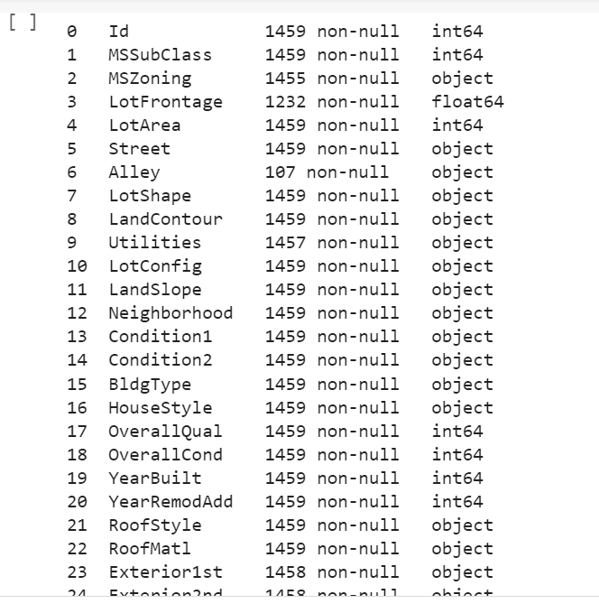
Following the information of datatypes of variables in the test data set.

Slide 31
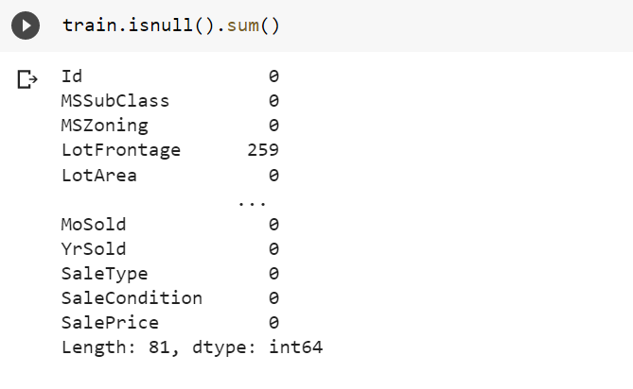
Here is the result for Null values in both data sets.
Below is the function to find the all the Null values in data set
train.isnull().sum()

Slide 32
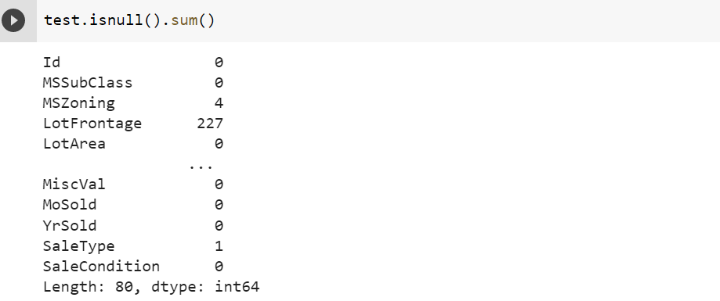
Here is the result for null values in the test data set
Test.isnull().sum()

Slide 33
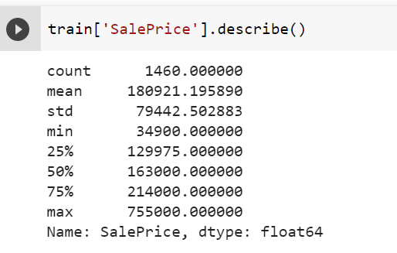
By using .describe(), we find the mean, median, 25%, 50%, etc. of the sales price in the train dataset shown below.

Slide 34
Skewness of data:
Skewness of data is nothing but a measure of symmetry in distribution.
Where a symmetrical dataset consists of skewness value which is equal to ‘0’
Bit we found the skewness of our dataset is “1.8828757597682129”.

Slide 35
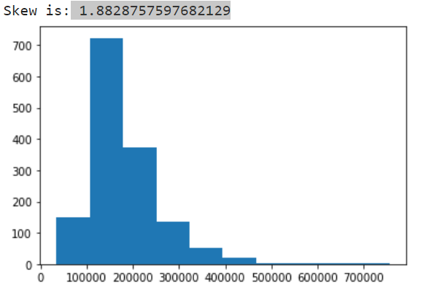

Slide 36
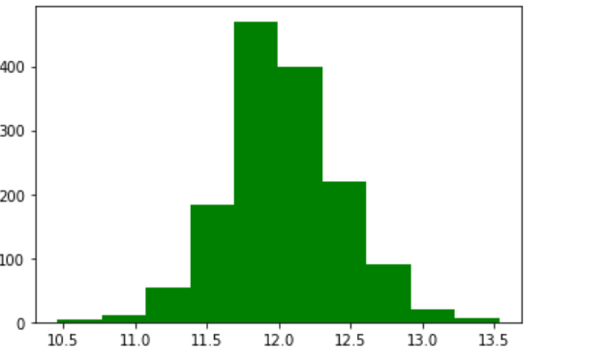
After applying log transform, the skewness of the sales price is reduced to the following value
0.12134661989685329

Slide 37
Importantly, the predictions generated by the final model will also be log-transformed, so we’ll need to convert these predictions back to their original form later.
Where np.log() is used to transform the variable, for reverse transformation will use np.exp().

Slide 38
Recap
Let’s make a quick glance at previous slides.
Abstract
Different types of regression models
Identifying customers
Constraints imposed by the customer
Assumptions and risks
Literature review
Execution steps

Slide 39
Here is the numerical features in train dataset such as
ID
MS Subclass
Overall Quality
Overall Condition
Year Built

Slide 40
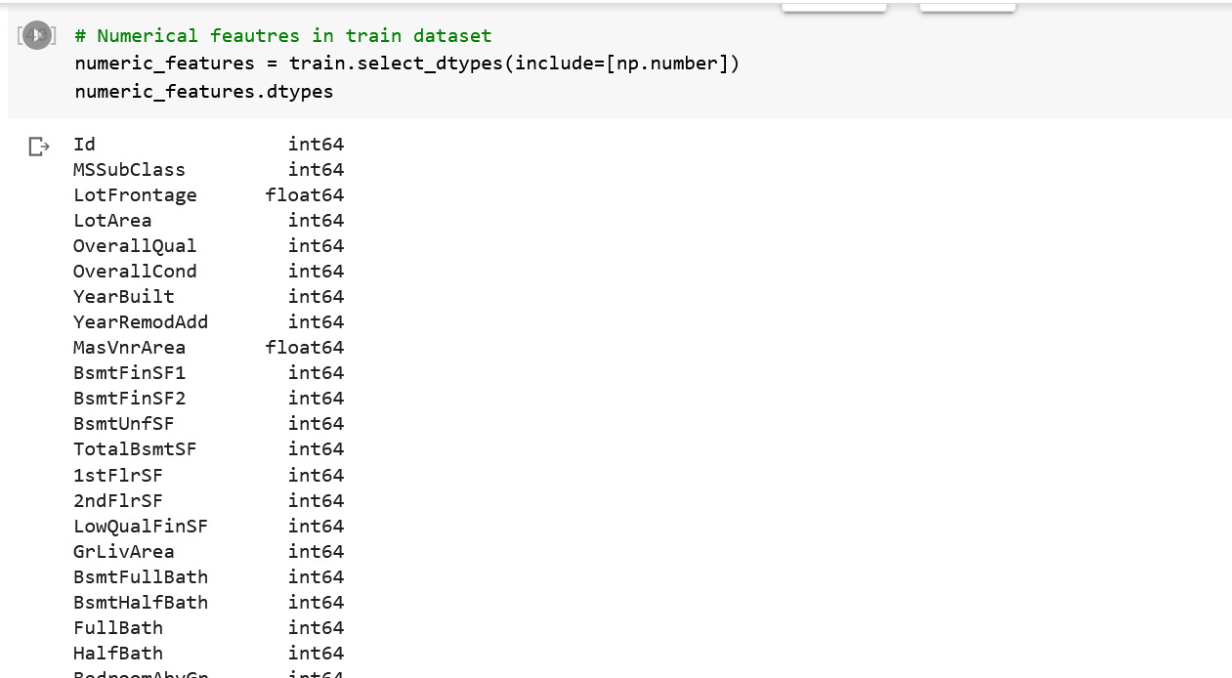

Slide 41
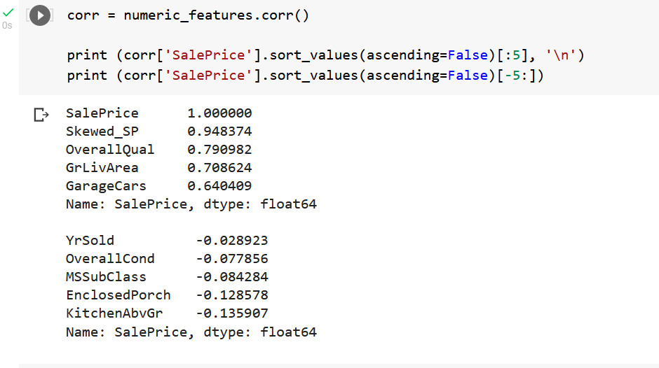
Correlation between numerical features.

Slide 42
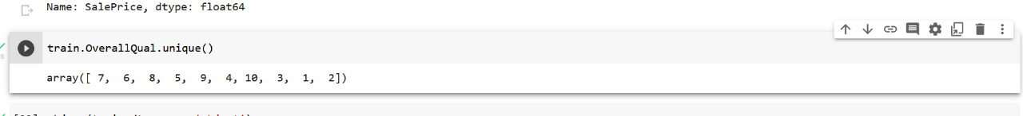
Here is the output of the overall quality of the houses like (1 story, 2story etc.) in the train dataset

Slide 43
We found the total count of every data type such as
Categorical
Int
Float

Slide 44
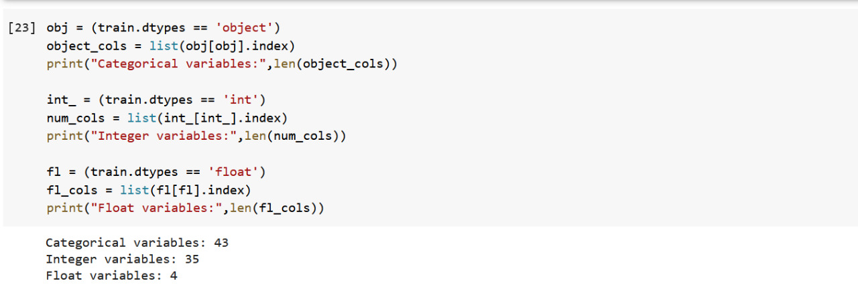

Slide 45
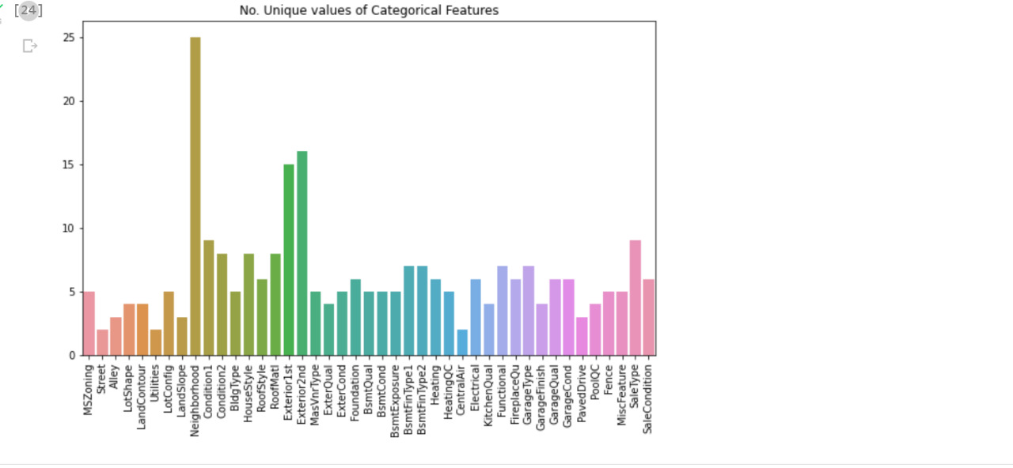
Here is the plot for the number of unique values of categorical features

Slide 46
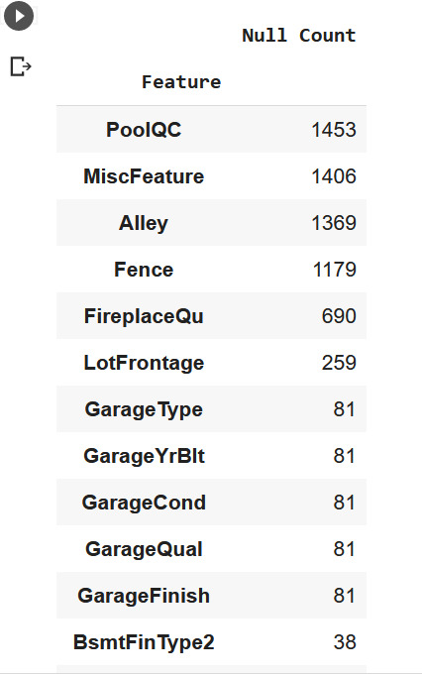
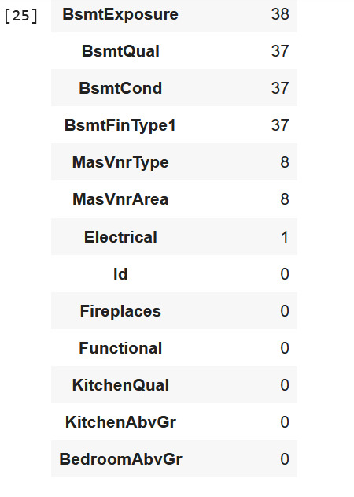
Total count of null values in the entire dataset

Slide 47
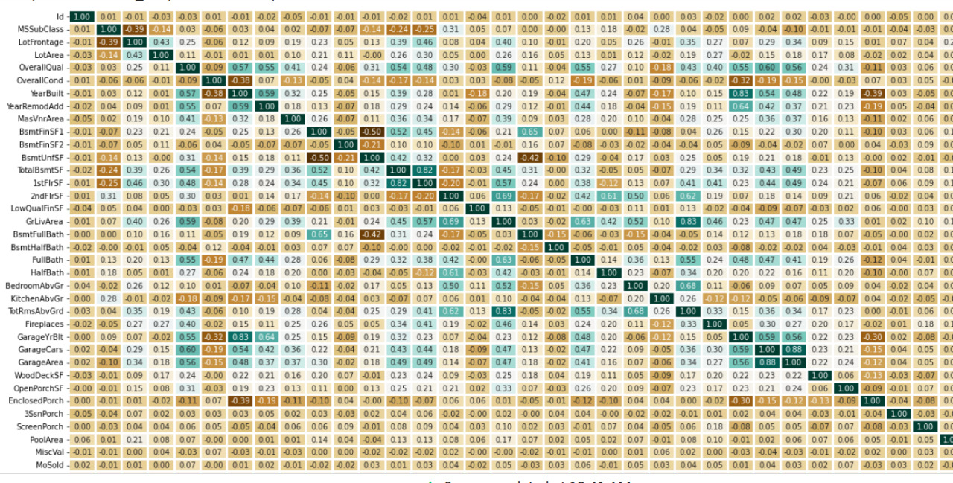
Now we can take a look at the correlation heatmap

Slide 48
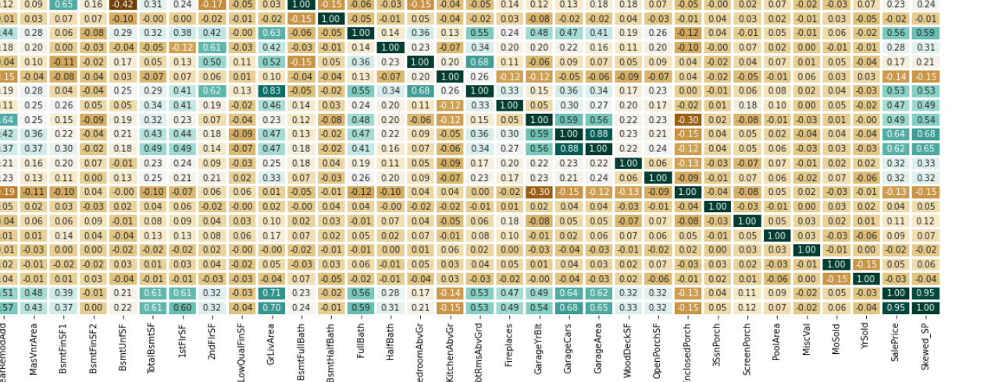

Slide 49
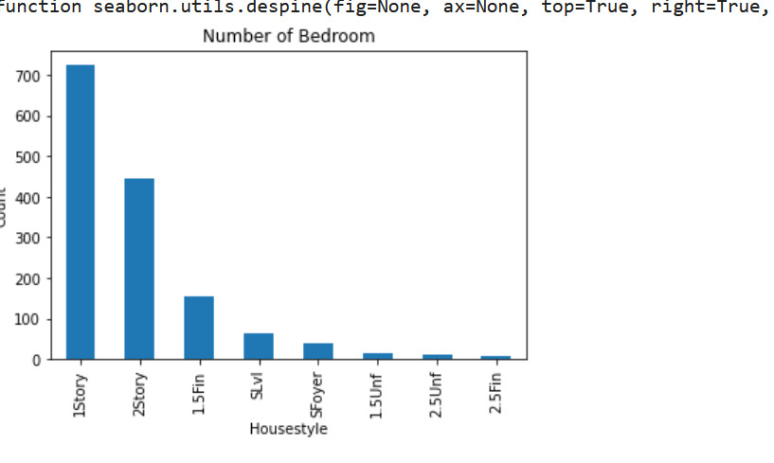
This plot shows the relation between type of houses and number of bedrooms.

Slide 50
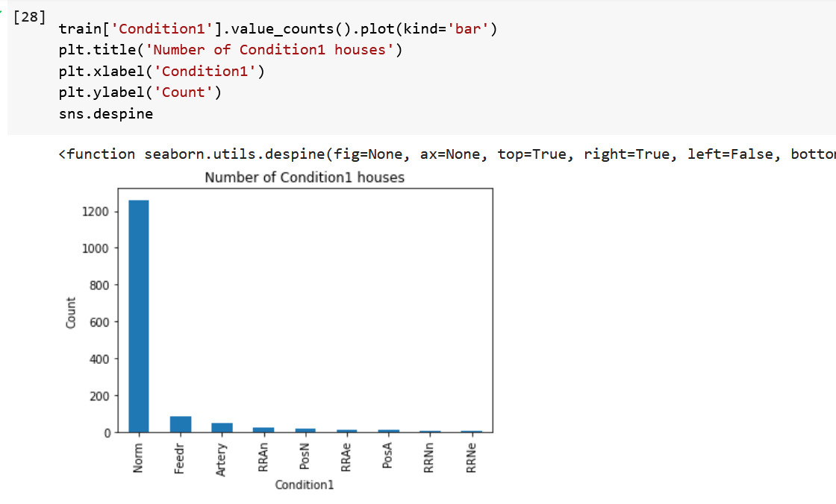
This plot represents the relation between condition 1 houses and its count.

Slide 51
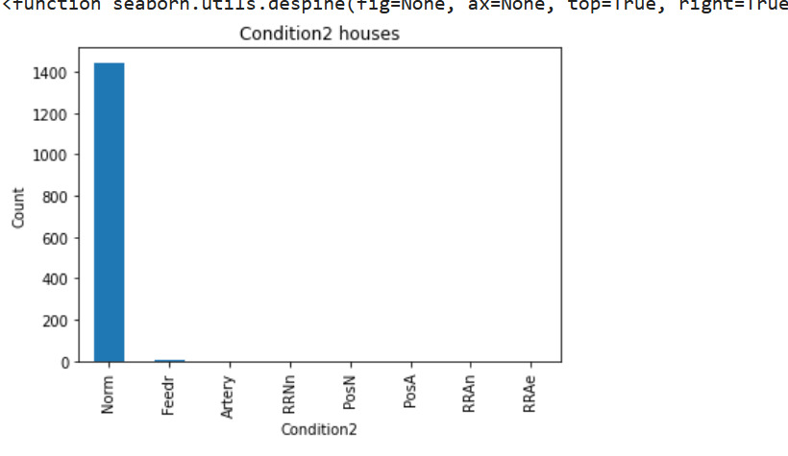
Condition 2 houses

Slide 52
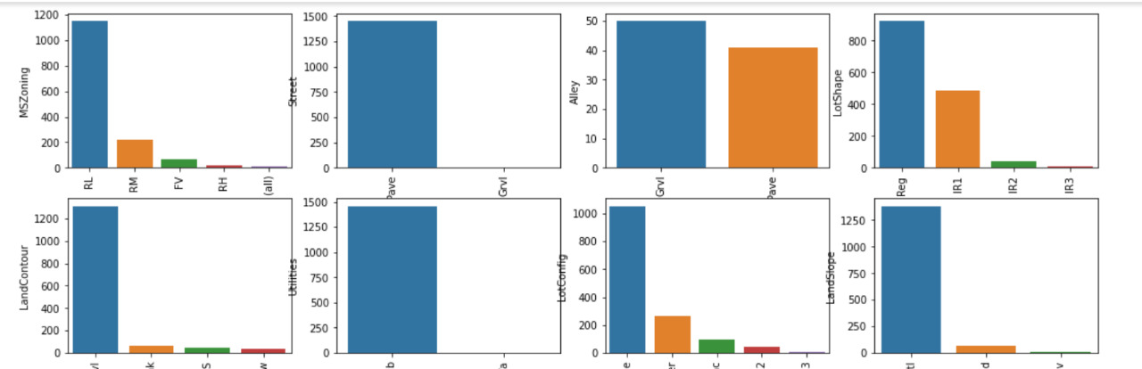
Followed by the types of houses here is the graphical representation for every variable with different subtypes and its count

Slide 53
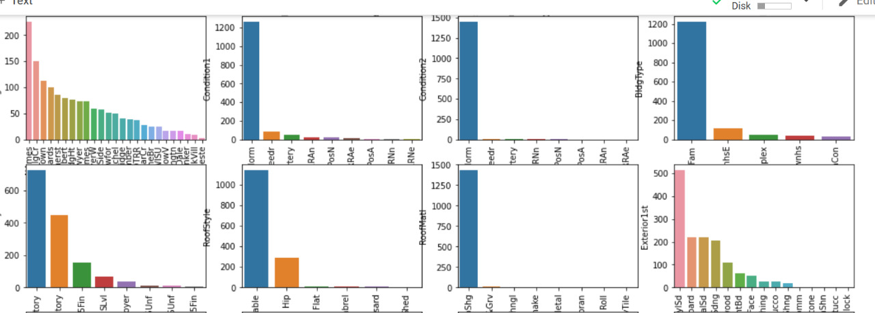

Slide 54
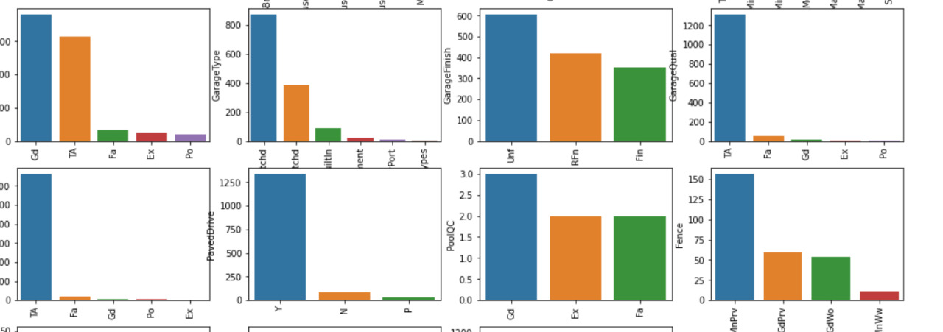

Slide 55
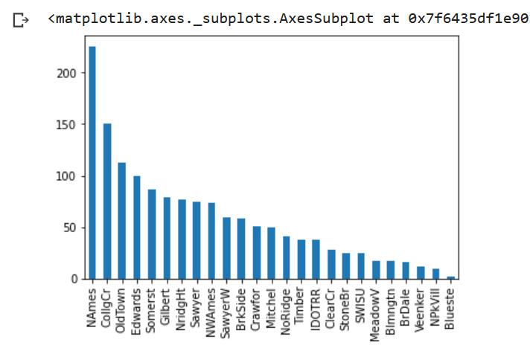
Here is the plot between neighborhood and total house count

Slide 56
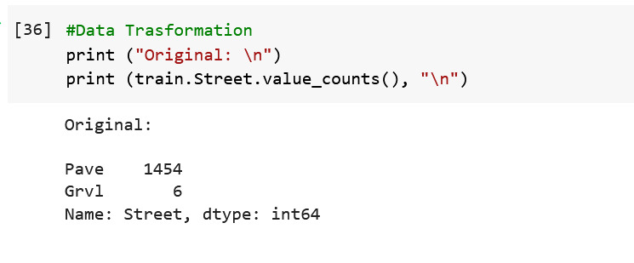
Data transformation
We found “street column” has highest number of categorical values so we need to transform those values into numerical data.

Slide 57
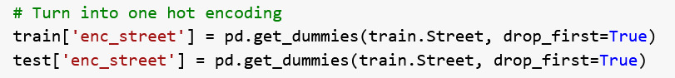
Here is the steps for “one hot encoding”

Slide 58
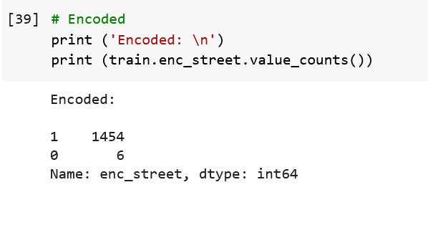
Output for “One hot encoding”

Slide 59
Thank You.

